Slide 1
Preschool Locator
The user Navigates to the FirstCry website
User clicks on Find Stores from the dropdown of Find stores and Preschools
The navigates to Store Locator section.
They select a store type (FirstCry), state (Bihar) and city (Chapra).
After search, the website displays a list of stores matching the selected criteria, including addresses and contact details.
Test Case Design
The process of creating test cases that outline specific conditions, inputs, actions and expected results to verify that a
system behaves as intended.
Cucumber
Cucumber is an open-source testing tool that supports Behavior-Driven Development (BDD).
That allows writing test scenarios in plain, human-readable language (Gherkin) It is a bridge the gap between technical and non-technical stakeholders.
It consists of Keywords like Feature, Scenario, Scenario Outline, Given, And ,When and Then .

Slide 2
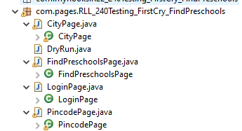
Example:
@pincode
Scenario Outline: Details by pincode
Given the user opens the Home page
When User clicks find preschool button
And user click on find preschools from the dropdown
When the user enters pincode <pincode>
And user clicks on the Submit button
Then the user should get result
Examples:
| pincode |
| 411014 |
| 111111 |
| 111 |
| |
Selenium
It is an open-source automation testing suite.
It used for automating web applications across different browsers and platforms.
It controls the browser by simulating user actions such as clicking, entering text, navigating pages.
Page Object Model (POM)
It is a design pattern used in test automation that creates an object repository for web elements.
Each web page or part of the application is represented as a class.
It consists of page elements (like buttons, fields, etc.) are defined as variables, while actions
(like clicks, inputs) are represented as methods.

Slide 3
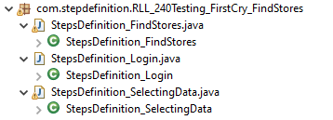
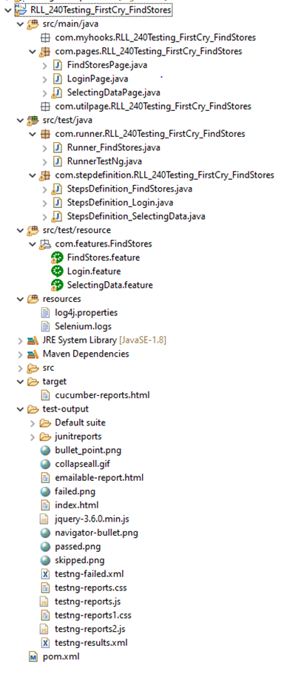

Behavior-Driven Development (BDD)
It is a Frame work or methodology rather than a specific tool and communication and shared
understanding among team members by using clear and concise language.
It is a step definition is the link between the human-readable Gherkin steps and the underlying
code logic.
Each step in a Gherkin feature file is mapped to a method in a step definition file.
TestNG
It contains test methods annotated with @Test and other annotations like @BeforeMethod,
@AfterMethod, @BeforeClass, and @AfterClass to manage the execution of test cases.
A TestNG report provides a detailed summary of test execution, showing passed, failed, and
skipped test cases.
It generates HTML reports by default, which include detailed logs, execution time,
and test status, helping in identifying test failures and successes easily.
TestNG Listeners are interfaces in TestNG that allow you to customize and take control of the
test execution lifecycle by listening to specific events (like test start, test success, test failure, etc.).
By implementing listeners, you can track the execution of tests and perform additional actions such as
generating custom reports, logging, taking screenshots on failure, or modifying test behavior dynamically.

Slide 4
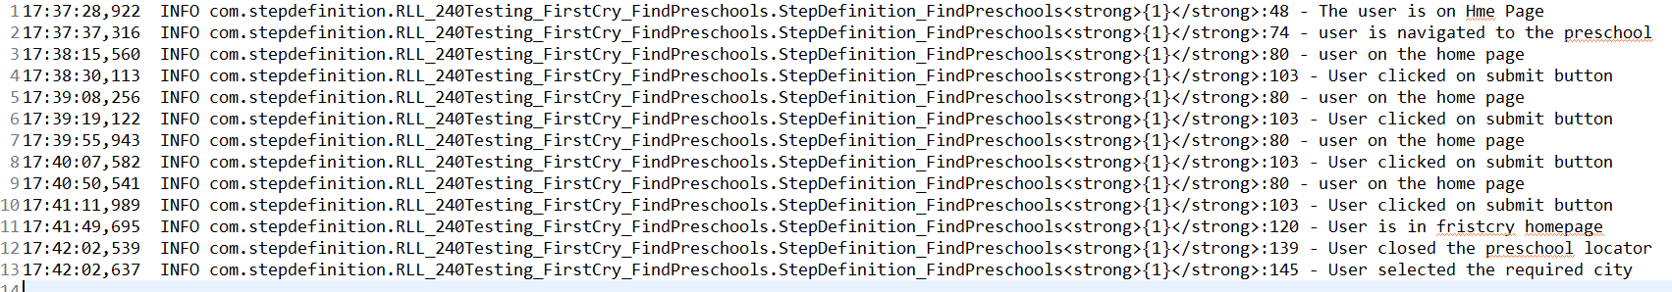
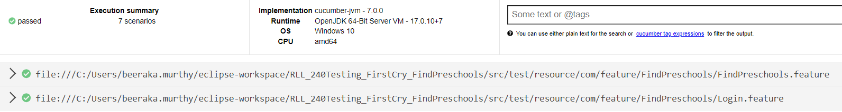
Framework
A test automation framework is a structured and organized set of rules, practices, and tools that guide how tests are created, executed, and managed.
Log4j
It allows developers to log messages during the execution of an application, which can help in monitoring, debugging, and troubleshooting.
Cucumber Reports
These reports give insights into how well the system meets the specified behaviors by showing which test scenarios passed, failed, or were skipped. The reports are generated in various formats such as HTML, JSON, or JUnit XML.
Extent Reports
It is a popular reporting library used in automation testing to generate highly detailed and customizable test reports. Extent Reports can be integrated with various automation frameworks, such as Selenium, TestNG, and Cucumber.

